Slide 1
Introduction to Research Data Management
Jane Fry, Carleton University
RDM Jumpstart Program
May 12, 2025

Slide 2
Outline of this session
Research data
Metadata
The research data lifecycle
Research data management (RDM)
The importance of RDM

Slide 3
Acronyms
Research Data Management
aka RDM
aka Data Management
aka DM
Data Management Plan
aka DMP
aka Research DMP
aka RDMP

Slide 4
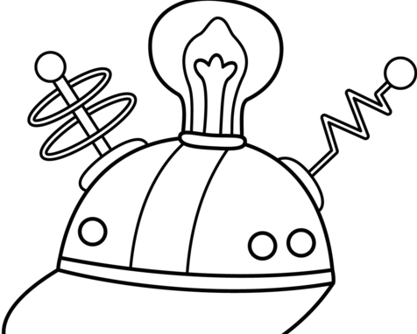
Research Data
What are they?
Need to know what they are before we start talking about them!
Thinking caps on!
Source: https://rb.gy/jxyudl
Notes:
Use the white board here to get everyone involved and thinking right away

Slide 5
Research Data (cont’d)
“Data are facts, observations or experiences on which an argument or theory is constructed or tested. Data may be numerical, descriptive, aural or visual. Data may be raw, abstracted or analysed, experimental or observational. Data include but are not limited to: laboratory notebooks; field notebooks; primary research data (including research data in hardcopy or in computer readable form); questionnaires; audiotapes; videotapes; models; photographs; films; and test responses. Research collections may include slides; artefacts; specimens; samples.”
Source: https://blogs.ucl.ac.uk/rdm/2015/09/what-is-research-data/

Slide 6
Research Data (cont’d)
“Research data are the original sources or material that you have created or collated to conduct your research project. They can be digital or non-digital. The response to your research question is based on the analysis of these research data.”
Source: https://blogs.ucl.ac.uk/rdm/2015/09/what-is-research-data/

Slide 7
Research Data (cont’d)
“Research data are data that are used as primary sources to support technical or scientific enquiry, research, scholarship, or creative practice, and that are used as evidence in the research process and/or are commonly accepted in the research community as necessary to validate research findings and results. Research data may be experimental data, observational data, operational data, third party data, public sector data, monitoring data, processed data, or repurposed data. What is considered relevant research data is often highly contextual, and determining what counts as such should be guided by disciplinary norms.”
(Tri-Agency)
Source: https://tinyurl.com/yx6ehw2r

Slide 8
Research Data (cont’d)
Why are they important?
Support original research
Deterrent to research fraud
When managed properly, they can be shared
Informally from one researcher to another
Deposited in a self-archiving system
Deposited in a specialist data repository dedicated to archiving, preserving and disseminating digital data
Deposited in an institutional repository
Why is sharing important?
We don’t conduct research in a bubble!
We will want to publish research about our data.

Slide 9
Sharing data considerations
Meets data-management requirements
Stability / security over time
Makes your data more visible
Requires documentation
Offers curation expertise that adds value to data
Facilitates data discovery and reuse through the development and standardization of metadata
Achieves interoperability across scientific communities
Authenticated online access to data / user access controls /licensing agreements
Fully searchable
Assigns unique persistent DOIs to files or collections
Reference: QDR & UKDS

Slide 10
Making Research Transparent
Requires:
Data access
What data were used, where are they, are they available?
Production transparency
Requires providing documentation describing how the data were generated / collected
Analytic transparency
How were data analyzed to arrive at conclusions?
How are evidence and claims connected?
Reference: QDR & UKDS

Slide 11
Benefits of Transparency
Makes research procedures clear
Facilitates more and deeper collaboration
Allows scholars to demonstrate the rigor and power of their work
Acts as an incentive to do good work
Facilitates learning of methodological lessons and teaching
Makes it more likely that research will be more useful to others
SUMMING UP: more accessible, honest, rigorous, relevant, and useful research!
Reference: QDR & UKDS

Slide 12
Example …
Political Persuasion and Attitude Change Study: The Los Angeles Longitudinal Field Experiments, 2013-2014
Principal Investigator: Michael J. LaCour
Reference: https://www.openicpsr.org/openicpsr/project/100037/version/V8/view
Notes:
Department of Political Science, University of California, Los Angeles (UCLA), Los Angeles, CA, USA
Got well known prof to write an article with him based on the data and it was published in Science
²Department of Political Science, Columbia University, New York, NY, USA.
Note here – after initial article was written, LaCour was offered a job at Stanford based on his research
Jan 2015, grad student (UC Berkeley) wanted to replicate the study and extend it because he was so impressed with the article and the research done on it

Slide 13
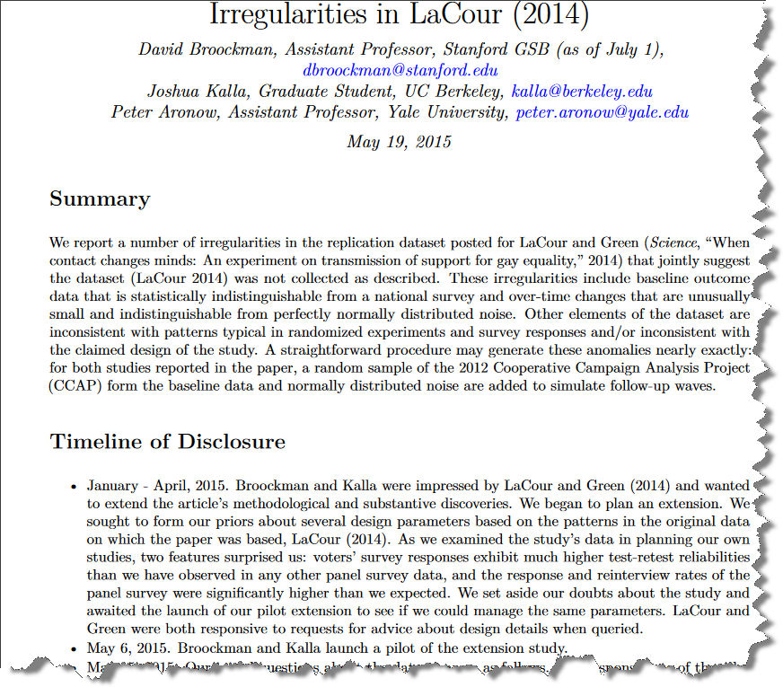
Reference: http://stanford.io/2bzRWFo

Slide 14
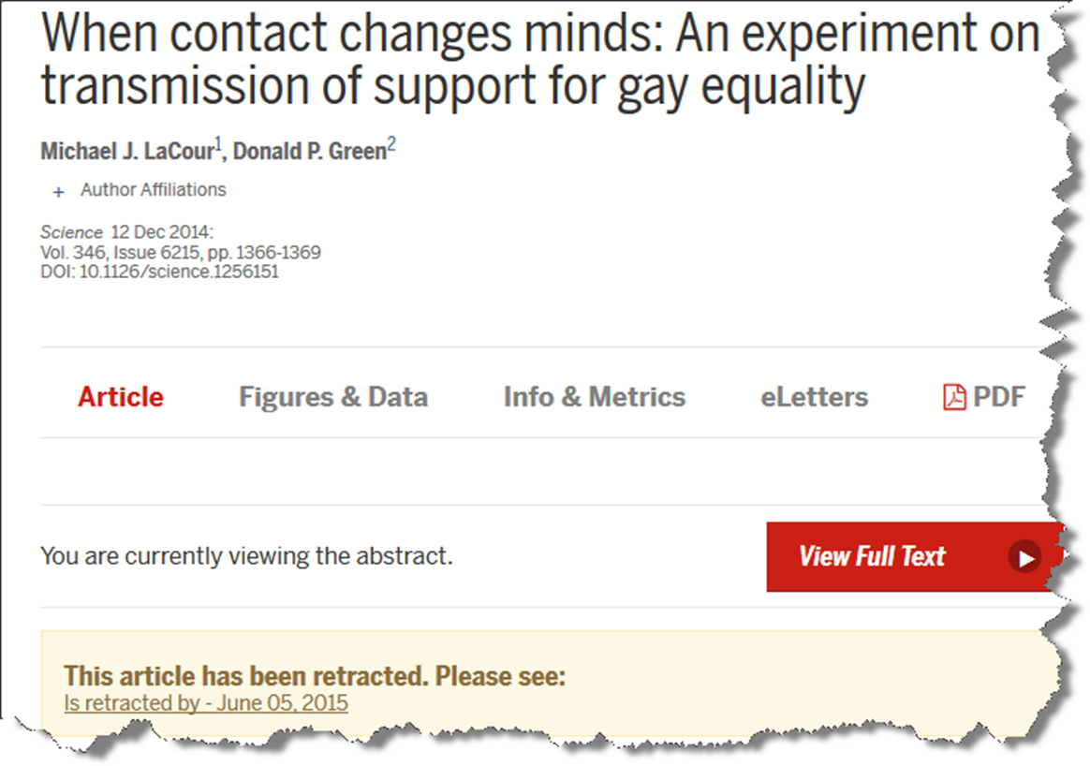
Reference: http://bit.ly/1NxWG5M

Slide 15
Something to think about …
Check out this story when you get a chance.
It will open your eyes about fake data and who is faking it.
When you have time …
Retraction Watch
Notes:
RW - Retractions by Nobel Prize winners; Top 10 most highly cited retracted papers; Papers and peer reviews with evidence of ChatGPT writing; …

Slide 16
Metadata
What are they?
Need to know what they are before we start talking about them!
Thinking caps on!
Source: https://rb.gy/jxyudl
Notes:
Use the white board here to get everyone involved and thinking again

Slide 17
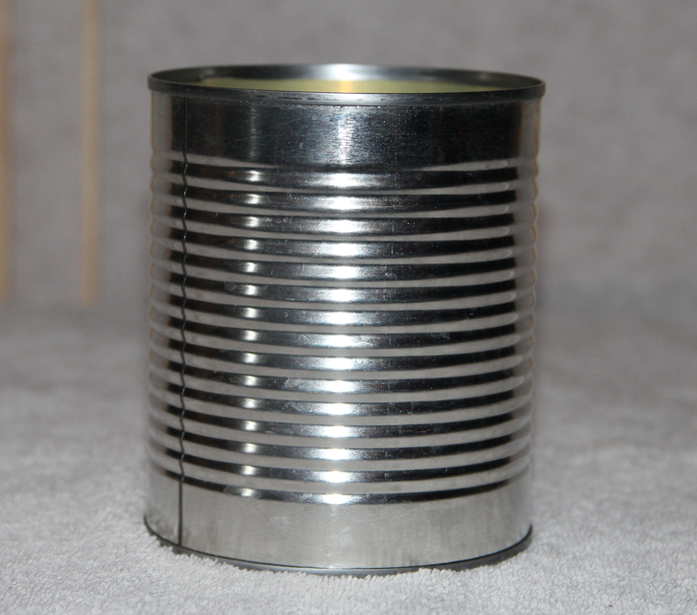

Slide 18
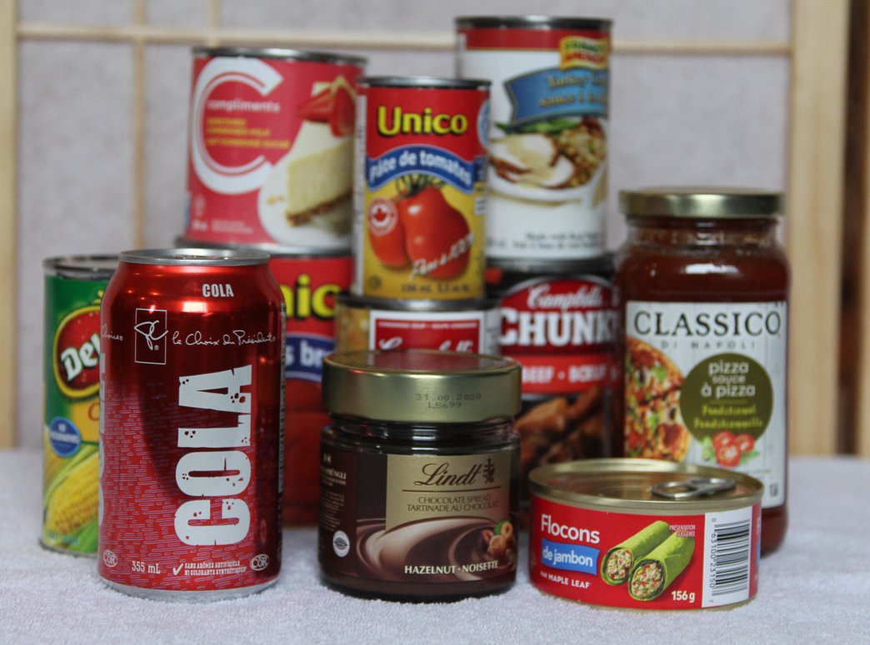

Slide 19
Metadata (cont’d)
What is it?
Explains …
Why is it important?
Who enters it?
Notes:
What - Metadata
---Information about the data
---usually presented in a standardized and structured format
Explains everything about the dataset
--purpose, time frame, geography, questions, …
Why – the key to the re-use of your research data
---it explains your dataset
-who--ideally, the original researcher – they are the one that best answer everything about the research
--this is the best one to explain the data, how it was collected, why the research was conducted, any issues or challenges that occurred, any problems with entering data or coding, …

Slide 20
Metadata (cont’d)
Why keep metadata?
When to record it?
What to keep?
Using a readme file
End goal …
Notes:
Why – good research practice; researchers re-use data; secondary analysis; replicate a study
Keep everything
Think about if you have a research team – you have to make sure that they record all their decisions.
--what happens if they are not around when you are writing your research paper? How will you know why they did what they did or didn’t do?
Readme file – when to use it – when you want the user to know how to use your datafiles properly and correctly. It is like a guide on how to use your data. It could also be used by yourself if you are revisiting your dataset a few years down the road because you won’t remember every little thing about . For example – if there is any jargon that you have used in your research and it seemed obvious at the time when you did your research, you should define it here as it may not be obvious a few years down the road. Note – it does not replace the other metadata that you will be recording in your data repository or your DMP.
End goal
- For this data to be replicated if necessary

Slide 21
Metadata (cont’d)
Survey metadata
Questionnaire
Data collection
Interviewer instructions
…
Notes:
There are many different types of metadata you need to help you understand a survey that has been done
Res design, Data collection, Data prep, Questionnaires – all versions, Interviewer instructions, Details of decisions made , why certain decisions were made or not, eg. Good Friday and alcohol survey, --what worked and didn’t work, Changes made after pilots conducted
Geographic information – where was it conducted
Who was the survey sample – anyone over 18?
How many ppl surveyed
When was it conducted – date and maybe the time depending on the survey
How was it conducted – F2F, internet, paper
Any info needed to read the data correctly
Any info needed to interpret the data

Slide 22
Questions?

Slide 23
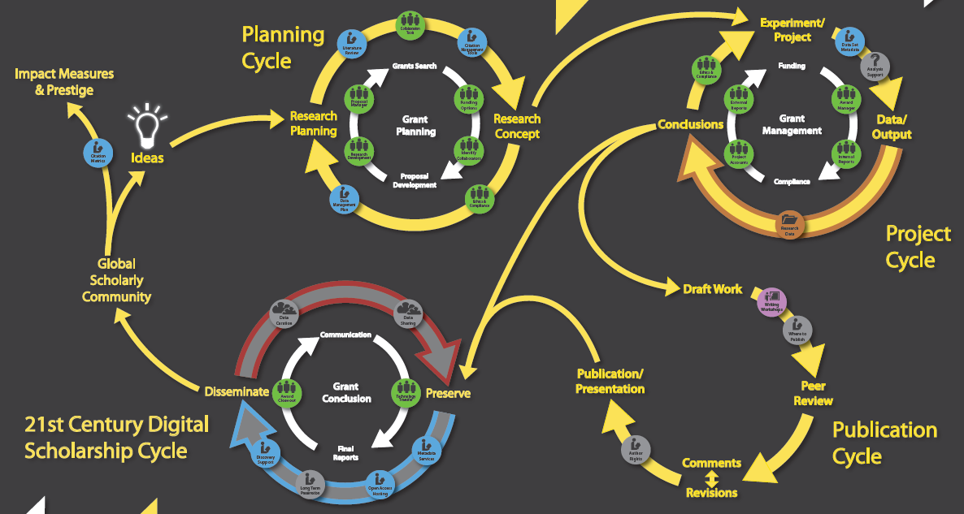

Slide 24
The Research Data Life Cycle
Many out there!
Many elements in common
Can be discipline-specific
The previous example is from the University of Centra Florida Libraries
We will NOT be using that one!

Slide 25
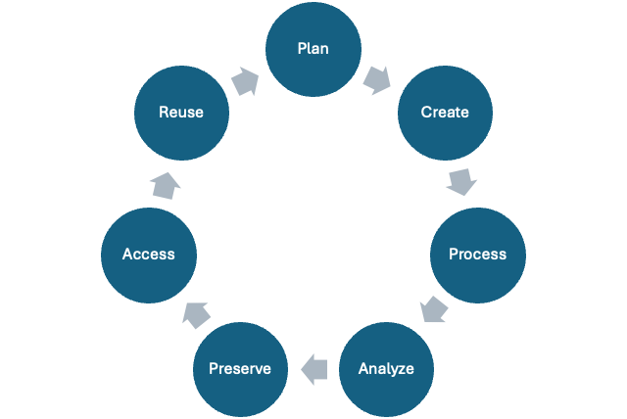
Notes:
Look at the different components of RDM
You can see how it is a circle so there is no end!

Slide 26
Plan
Data Management Plan
More on that later!

Slide 27
Create
Design research
Locate existing data
Collect data (experiment, observe, measure, simulate)
Capture and create metadata

Slide 28
Process
Enter data, digitise, transcribe, translate
Check, validate, clean data
Anonymise data where necessary
Describe data
Manage and store data
Notes:
Process the data

Slide 29
Analyse
Interpret data
Derive data
Produce research outputs
Think about Author publications
Prepare data for preservation

Slide 30
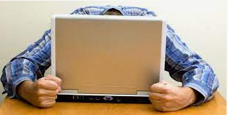
Preserve
Migrate data to best format
Non-proprietary best
Back-up and store data
3-2-1
Create metadata and documentation
Archive data
Source: https://www.datarecoverygroup.com/articles/types-data-loss
Notes:
3 copies of the dta, 2 different mediums, 1 offsite

Slide 31
Access
Determine what the access will be
Distribute data
Share data
Promote data

Slide 32
Reuse
Follow-up research
New research
Scrutinize findings
Teaching and learning

Slide 33
Notes:
Should mention here that the stages can be a bit artificial and non-linear, but this is a good conceptual framework which you can apply to your research projects

Slide 34
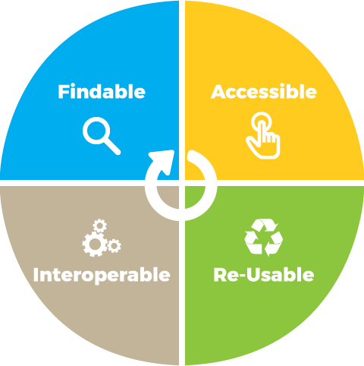
FAIR
An international guiding principle focused towards making data
Findable
Accessible
Interoperable
Reusable
Key Resource: go-fair.org
https://www.go-fair.org/fair-principles/

Slide 35
FAIR (cont’d)
Findable
Data & supplementary materials have sufficiently rich metadata, and a unique and persistent identifier.
Accessible
Metadata & data are understandable to humans and machines. Data is deposited in a trusted repository.
Interoperable
Metadata use a formal, accessible, shared, and broadly applicable language for knowledge representation.
Reusable
Data & collections have clear usage licenses and provide accurate information on provenance.
Notes:
Accessible – not on a website!

Slide 36
Questions?

Slide 37
RDM
We have been talking RDM since the beginning!
What is RDM?
“It encompasses the processes applied throughout the lifecycle of a research project to guide the collection, documentation, storage, sharing, and preservation of research data, and allows researchers to find and access data.”
Source: https://alliancecan.ca/en/services/research-data-management
Includes:
Sound practices; data curation; and data stewardship
Notes:
Since the beginning – research data, the data lifecycle, metadata, good research practices
I just didn’t label it as RDM!
Wanted to give you a gentle introduction to it and to make you realize that you already know what it is
Def’n – simplistic one – managing research data throughout the research life cycle
--sounds simple but that is what it is – it is not rocket science
---The application of sound practices in the creation of data for current and future research
---Data curation – the preservation and maintenance of digital assets
---Data stewardship for the lifecycle of a research project

Slide 38
Benefits of RDM
Confirmation of original findings
Further research
Planning follow-up studies
Bonus …
Notes:
You will probably already know many of the benefits because of what we have already discussed
Confirmation
--replication of results
--Prevention of research fraud
--They are essential for you to defend your research
future research
---answering questions not undertaken in the original research
Planning follow up studies
--bldg. on original data by introducing a time factor
- Bonus – help you to conduct your research more efficiently

Slide 39
Tri-Council RDM Policy Policy
Finalized in 2021
After many years of consultation, revision ,,,
Policy Objective
“to support Canadian research excellence by promoting sound data management and data stewardship practices. This policy is not an open data policy.”
Source: http://www.science.gc.ca/eic/site/063.nsf/eng/h_97610.html

Slide 40
Tri-Council RDM Policy (cont’d) RDM M Policy
to promote “the importance of data management to researchers, staff & students”
to guide “researchers on how to properly manage data”
to provide, or support “access to, repository services or other platforms that securely preserve, curate and provide appropriate access to research data”
Source: http://www.science.gc.ca/eic/site/063.nsf/eng/h_97610.html

Slide 41
Tri-Council RDM Policy (cont’d) RDM M Policy
Created around 3 pillars
Creating an institutional RDM strategy
by March 1, 2023
220 research institutions have complied
Data Management plans starting in spring 2022
Being rolled out slowly
Will eventually be a requirement for researchers for all funding received
Data deposit requirement for researchers
Starting Fall 2025
Being rolled out slowly
Source: http://www.science.gc.ca/eic/site/063.nsf/eng/h_97610.html
Notes:
Each research institution eligible for Tri-A funding had to create one – they were given a couple of years to do it
When it was done, they had to post it to the website
Data deposit – as open as possible.
However, the agencies expect researchers to provide appropriate access to the data where ethical, cultural, legal and commercial requirements allow, and in accordance with the FAIR principles and the standards of their disciplines. Whenever possible, these data, metadata and code should be linked to the publication with a persistent digital identifier.

Slide 42
And …
What could happen if you don’t practice good RDM?
https://www.youtube.com/watch?v=N2zK3sAtr-4#t=17

Slide 43
Summing it up …
Hopefully you have learned
What is research data
What is metadata
What is RDM
Why is it important
RDM best practices
Notes:
I hope you didn’t mind my backwards approach – to me it was important that you realize that there are already many elements of RDM that you already know 0 you just haven’t it as such

Slide 44
Questions?

Slide 45
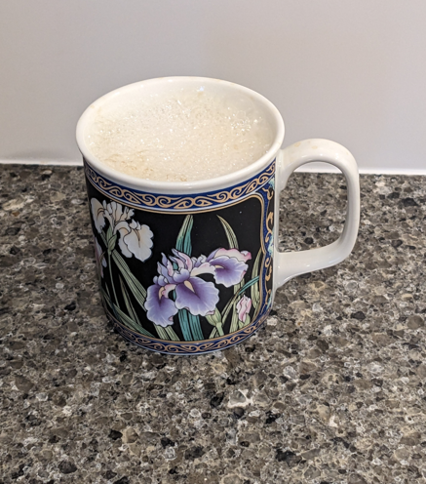
Please log into OSF during the break!

Slide 46
References
Qualitative Data Repository & UK Data Services (2016). “Managing and Sharing Data and Achieving Research Transparency”. Syracuse University.
https://slideplayer.com/slide/12627589/
Retraction Watch
https://retractionwatch.com/
Tri-Agency Statement of Principles on Digital Data Management
https://science.gc.ca/site/science/en/interagency-research-funding/policies-and- guidelines/research-data-management/tri-agency-statement-principles-digital-data-management
Tri-Agency Statement of Principles on Digital Data Management
https://science.gc.ca/site/science/en/interagency-research-funding/policies-and-guidelines/research-data-management

Slide 47
More Resources
Changes in Data Sharing and Data Reuse Practices and Perceptions among Scientists Worldwide”. August 2015. C. Tenopir et al. https://journals.plos.org/plosone/article?id=10.1371/journal.pone.0134826
“ReadMe Best Practices”
https://ubc-library-rc.github.io/rdm/content/03_create_readme.html
“Store and back up”
https://ubc-library-rc.github.io/rdm/content/06-3_Storage_Backup.html
“The Enduring Value of Social Science Research: The Use and Reuse of Primary Research Data”. A. Pienta, G. Alter, J. Lyle., November 2010.
http://hdl.handle.net/2027.42/78307

Slide 48
More Resources
Care Principles for Indigenous Data Governance
https://www.gida-global.org/care
OCAP®, The First Nations Principles
https://fnigc.ca/ocap-training/

